Slide 1
JavaScript Essentials
Conditionals

Slide 2
Table of Contents
Overview – What is condition ?
if…else statement
switch statements
ternary operator
Q&A

Slide 3

Lesson Objectives
Understand the needs to make decisions and carry out actions accordingly depending on different inputs, scenario
Understand how conditional statements work in JavaScript
Able to use if…else, switch, ternary operator with ease to make decisions

Slide 4
Overview – What is a condition?
Section 1

Slide 5
Overview – What is a condition?
In any programming language, the code needs to make decisions and carry out actions accordingly depending on different inputs.
For example: in a game, if the player's number of lives is 0, then it's game over.
In a weather app, if it is being looked at in the morning, show a sunrise graphic; show stars and a moon if it is nighttime.
Notes:
In any programming language, the code needs to make decisions and carry out actions accordingly depending on different inputs.
For example, in a game, if the player's number of lives is 0, then it's game over.
In a weather app, if it is being looked at in the morning, show a sunrise graphic; show stars and a moon if it is nighttime. In this article, we'll explore how so-called conditional statements work in JavaScript.

Slide 6
Overview – What is a condition?
Notes:
Human beings (and other animals) make decisions all the time that affect their lives, from small ("should I eat one cookie or two?") to large ("should I stay in my home country and work on my father's farm, or should I move to America and study astrophysics?")
Conditional statements allow us to represent such decision making in JavaScript, from the choice that must be made (for example, "one cookie or two"), to the resulting outcome of those choices (perhaps the outcome of "ate one cookie" might be "still felt hungry", and the outcome of "ate two cookies" might be "felt full, but mom scolded me for eating all the cookies".)

Slide 7
Overview – Summary
Conditional plays a big role in any Programming language
It helps to make decisions and carry out actions accordingly depending on different inputs
JavaScript provide such conditionals or control flow mechanism

Slide 8
if…else statement
Section 2

Slide 9
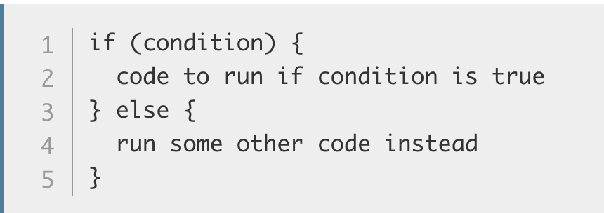
if…else statement – Basic syntax
Let's look at by far the most common type of conditional statement you'll use in JavaScript — the humble if...else statement.
Basic if...else syntax looks like the following in pseudocode:
Notes:
Here we've got:
The keyword if followed by some parentheses.
A condition to test, placed inside the parentheses (typically "is this value bigger than this other value?", or "does this value exist?"). The condition makes use of the comparison operators we discussed in the last module and returns true or false.
A set of curly braces, inside which we have some code — this can be any code we like, and it only runs if the condition returns true.
The keyword else.
Another set of curly braces, inside which we have some more code — this can be any code we like, and it only runs if the condition is not true — or in other words, the condition is false.
This code is pretty human-readable — it is saying "if the condition returns true, run code A, else run code B"

Slide 10
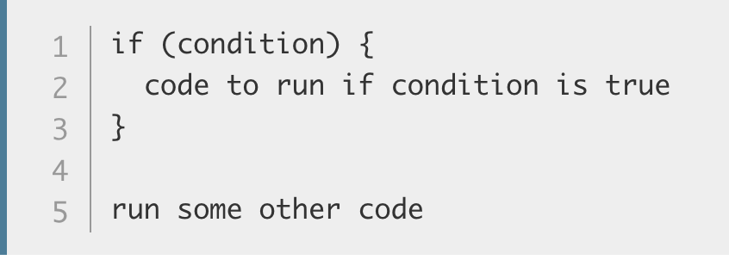
if…else statement – Basic syntax
You should note that you don't have to include the else and the second curly brace block — the following is also perfectly legal code:
Notes:
However, you need to be careful here — in this case, the second block of code is not controlled by the conditional statement, so it always runs, regardless of whether the condition returns true or false. This is not necessarily a bad thing, but it might not be what you want — often you want to run one block of code or the other, not both.

Slide 11
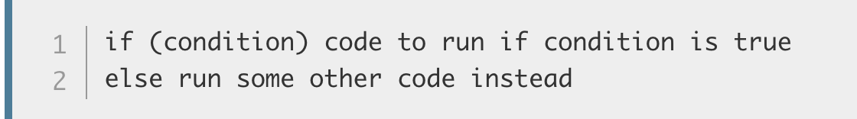
if…else statement – Basic syntax
As a final point, you may sometimes see if...else statements written without the curly braces, in the following shorthand style:
Not recommended
Notes:
As a final point, you may sometimes see if...else statements written without the curly braces, in the following shorthand style:
if (condition) code to run if condition is true else run some other code insteadThis is perfectly valid code, but using it is not recommended — it is much easier to read the code and work out what is going on if you use the curly braces to delimit the blocks of code, and use multiple lines and indentation.
Example 1:
To understand this syntax better, let's consider a real example. Imagine a child being asked for help with a chore by their mother or father. The parent might say "Hey sweetheart! If you help me by going and doing the shopping, I'll give you some extra allowance so you can afford that toy you wanted." In JavaScript, we could represent this like so:
let shoppingDone = false; if (shoppingDone === true) { let childsAllowance = 10; } else { let childsAllowance = 5; }This code as shown always results in the shoppingDone variable returning false, meaning disappointment for our poor child. It'd be up to us to provide a mechanism for the parent to set the shoppingDone variable to true if the child did the shopping.
https://github.com/mdn/learning-area/blob/master/javascript/building-blocks/allowance-updater.html
Example 2:
https://github.com/mdn/learning-area/blob/master/javascript/building-blocks/simple-else-if.html

Slide 12
if…else statement – Basic syntax
Example 1: The parent might say "Hey sweetheart! If you help me by going and doing the shopping, I'll give you some extra allowance so you can afford that toy you wanted."
Notes:
Example 1: (Check Unit 7 – Example 1)

Slide 13
if…else statement – Basic syntax
The last example provided us with two choices, or outcomes — but what if we want more than two?
There is a way to chain on extra choices/outcomes to your if...else — using else if. Each extra choice requires an additional block to put in between if() { ... } and else { ... }
Example 2: Checking weather
Notes:
Example 2 (Check Unit 7 – Example 2)

Slide 14
if…else statement – Tip on condition
Comparison operators are used to test the conditions inside our conditional statements
=== and !== : test if one value is identical to, or not identical to, another.
< and > : test if one value is less than or greater than another.
<= and >= : test if one value is less than or equal to, or greater than or equal to, another.

Slide 15
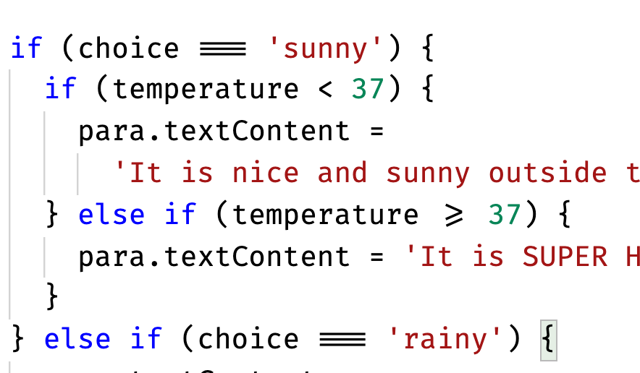
if…else statement – Nesting if…else
It is perfectly OK to put one if...else statement inside another one — to nest them.
Notes:
For example, we could update our weather forecast application to show a further set of choices depending on what the temperature is:

Slide 16
if…else statement – Logical operators
If you want to test multiple conditions without writing nested if...else statements, logical operators can help you. When used in conditions, the first two do the following:
&& — AND
|| — OR
Notes:
&& — AND; allows you to chain together two or more expressions so that all of them have to individually evaluate to true for the whole expression to return true.
|| — OR; allows you to chain together two or more expressions so that one or more of them have to individually evaluate to true for the whole expression to return true.

Slide 17
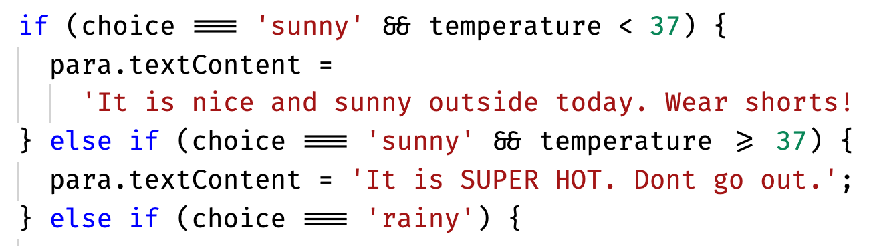
if…else statement – Logical operators
To give you an AND example, the previous example snippet can be rewritten to this:
Notes:
So for example, the first code block will only be run if choice === 'sunny' and temperature <= 37 return true.

Slide 18
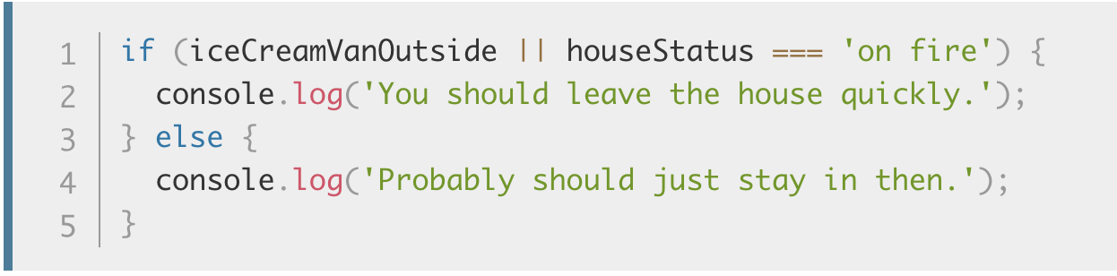
if…else statement – Logical operators
Let's look at a quick OR example:
Notes:
The last type of logical operator, NOT, expressed by the ! operator, can be used to negate an expression. Let's combine it with OR in the above example:

Slide 19
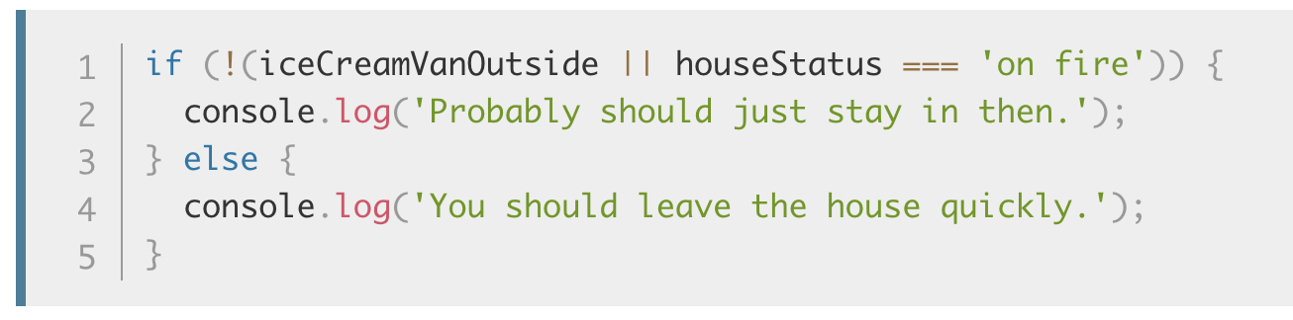
if…else statement – Logical operators
The last type of logical operator, NOT, expressed by the ! operator, can be used to negate an expression. Let's combine it with OR in the above example:
Notes:
In this snippet, if the OR statement returns true, the NOT operator will negate it so that the overall expression returns false.

Slide 20
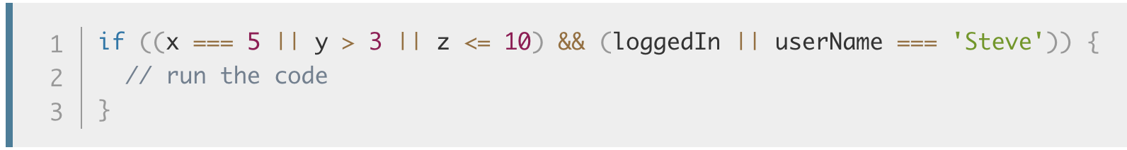
if…else statement – Logical operators
You can combine as many logical statements together as you want, in whatever structure
Notes:
The following example executes the code inside only if both OR statements return true, meaning that the overall AND statement will return true

Slide 21
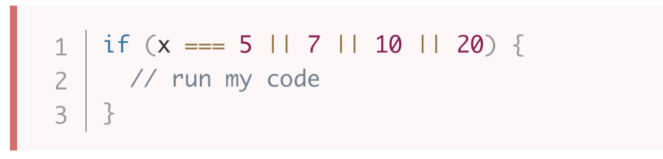
if…else statement – Logical operators
Common mistake (wrong syntax):
Notes:
A common mistake when using the logical OR operator in conditional statements is to try to state the variable whose value you are checking once, and then give a list of values it could be to return true, separated by || (OR) operators.
In this case the condition inside if(...) will always evaluate to true since 7 (or any other non-zero value) always evaluates to true.
This condition is actually saying "if x equals 5, or 7 is true — which it always is". This is logically not what we want! To make this work you've got to specify a complete test either side of each OR operator:

Slide 22
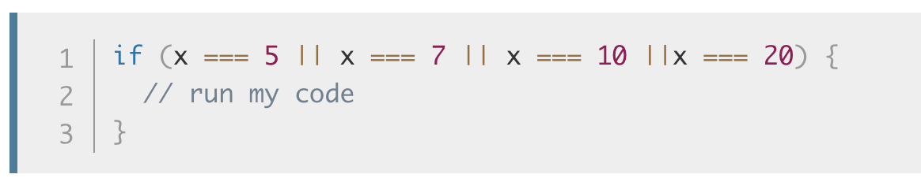
if…else statement – Logical operators
This is logically not what we want!
To make this work you've got to specify a complete test either side of each OR operator:

Slide 23
if…else - Summary
if…else is probably the most common type of conditional statement in JavaScript
Basic syntax: if …else
You can have as much else…if as you need
You can nest as much if…else as you want (Not recommended)
Make use of Logical operators to strike for cleaner and easy to understandab code
3 type of logical operators: AND, OR, NOT

Slide 24
switch statement
Section 3
Notes:
Assignment operators

Slide 25
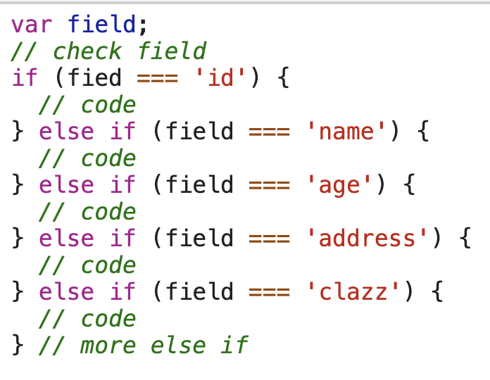
switch statement – Problem with if…else
if...else statements do the job of enabling conditional code well, but they are not without their downsides.
Notes:
They are mainly good for cases where you've got a couple of choices, and each one requires a reasonable amount of code to be run, and/or the conditions are complex (for example, multiple logical operators).
For cases where you just want to set a variable to a certain choice of value or print out a particular statement depending on a condition, the syntax can be a bit cumbersome, especially if you've got a large number of choices.

Slide 26
switch statement – For the rescue
In such a case, switch statements are your friend
It takes a single expression/value as an input,
Look through a number of choices until they find one that matches that value
Executing the corresponding code that goes along with it.

Slide 27
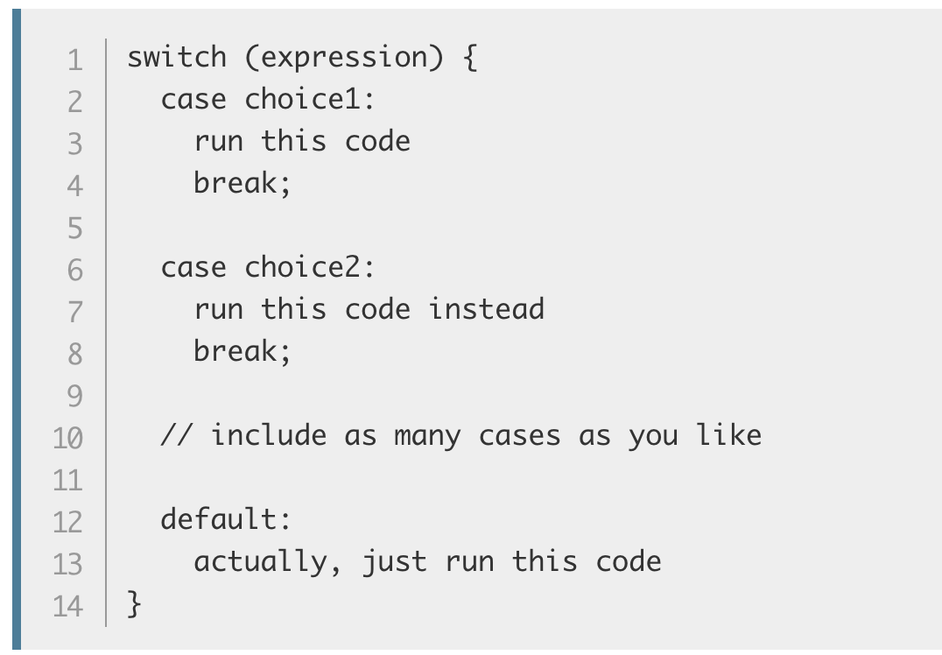
switch statement – For the rescue
Here's some more pseudocode, to give you an idea:
Notes:
Here we've got:
The keyword switch, followed by a set of parentheses.
An expression or value inside the parentheses.
The keyword case, followed by a choice that the expression/value could be, followed by a colon.
Some code to run if the choice matches the expression.
A break statement, followed by a semi-colon. If the previous choice matches the expression/value, the browser stops executing the code block here, and moves on to any code that appears below the switch statement.
As many other cases (bullets 3–5) as you like.
The keyword default, followed by exactly the same code pattern as one of the cases (bullets 3–5), except that default does not have a choice after it, and you don't need to break statement as there is nothing to run after this in the block anyway. This is the default option that runs if none of the choices match.
Note: You don't have to include the default section — you can safely omit it if there is no chance that the expression could end up equaling an unknown value. If there is a chance of this, however, you need to include it to handle unknown cases.

Slide 28
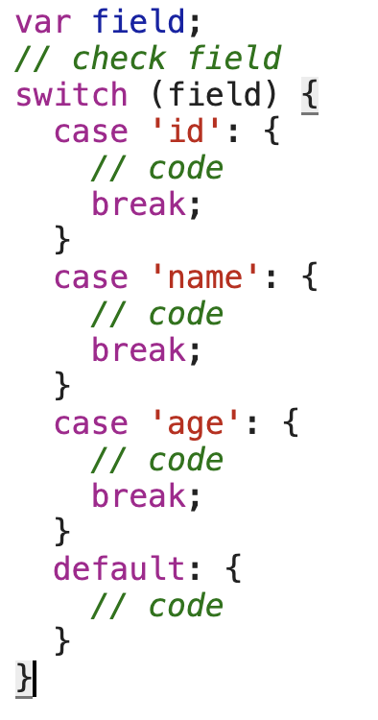
switch statement – For the rescue
Convert previous example to switch:

Slide 29
Practice 1:
Practice 1: switch statement
Notes:
Change the Example 2 to use switch
Check Unit 7 – Practice 1

Slide 30
switch statement - Summary
When you get a large number of choices think about switch
Syntax for switch is: switch (value) { case: }
default case is optional but it’s recommended to include one
Do not forget the break keywork if you don’t want your program to behave strangely

Slide 31
Ternary operator
Section 4
Notes:
Assignment operators

Slide 32
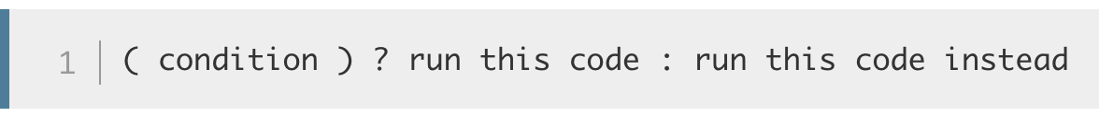
Ternary operator – Syntax
The ternary or conditional operator is a small bit of syntax that tests a condition and returns one value/expression if it is true, and another if it is false
The pseudocode looks like this:
Notes:
— this can be useful in some situations, and can take up a lot less code than an if...else block if you simply have two choices that are chosen between via a true/false condition.

Slide 33
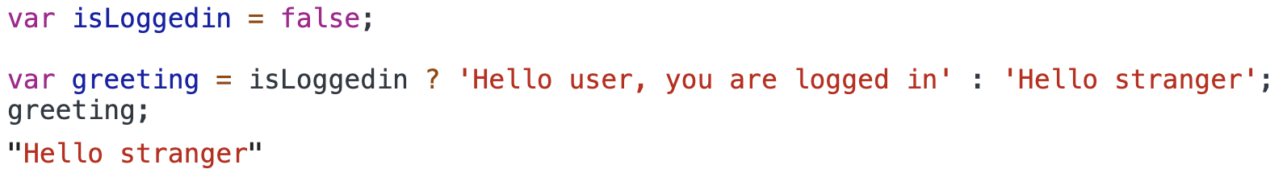
Ternary operator – Example
So let's look at a simple example:
Notes:
Or toggle complete todo

Slide 34
Practice 2
Practice 2: ternary operator
Notes:
Check Unit 7 – Practice 2
Theme chooser: // number 1
// if select value is black call update('black','white')
// if not then call update('white','black')

Slide 35
Ternary operator - Summary
Useful in some situations, and can take up a lot less code than an if...else block if you simply have two choices that are chosen between via a true/false condition.
Is an expression not a statement so it can be anywhere that expects an expression, for example: on the right side of = operator, an item an array, condition in if…else or switch, in template string and logical operators and much more

Slide 36

Thank you
Q&A

